Slide 1

Case study of ms Shiv Shakti Traders

Slide 2


Slide 3


Slide 5
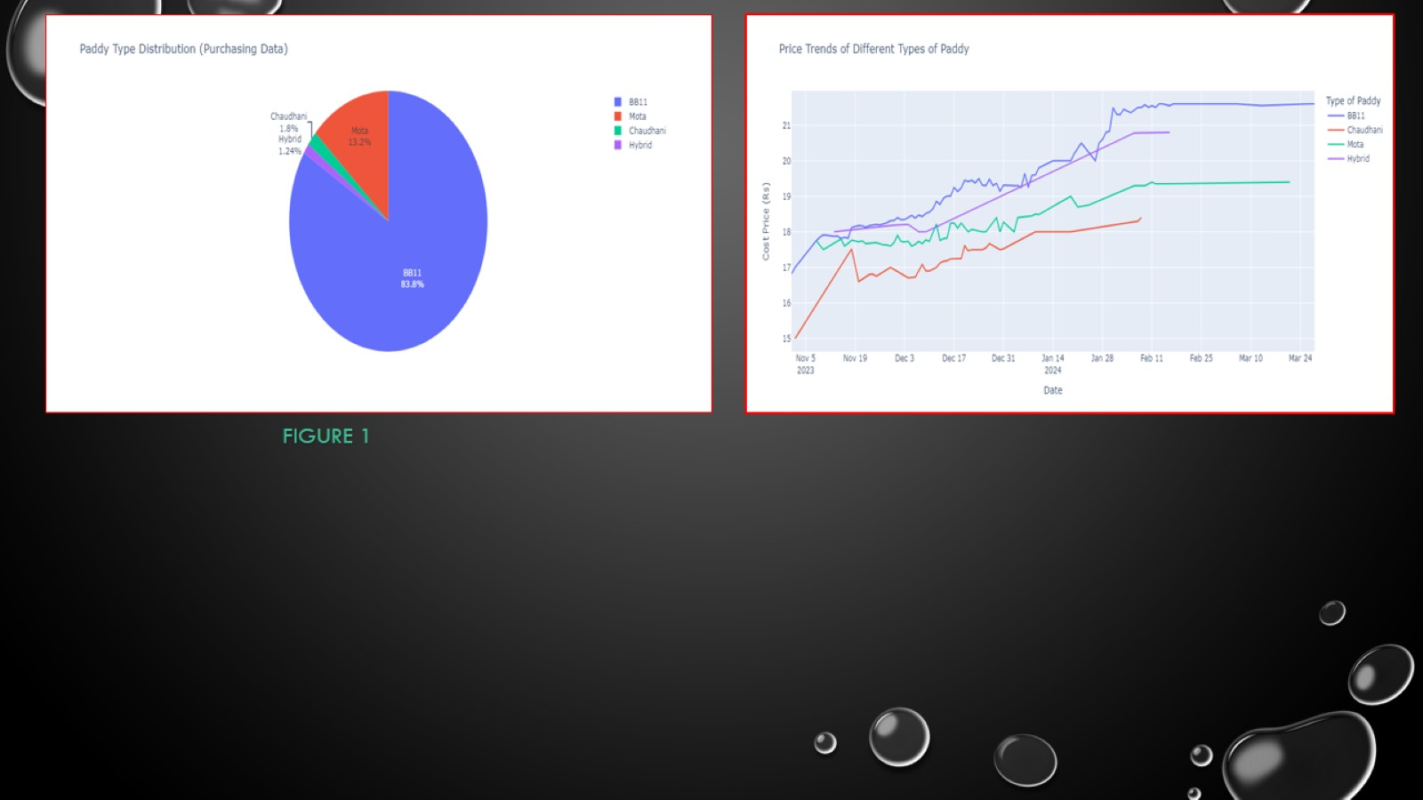
ffff

Slide 6
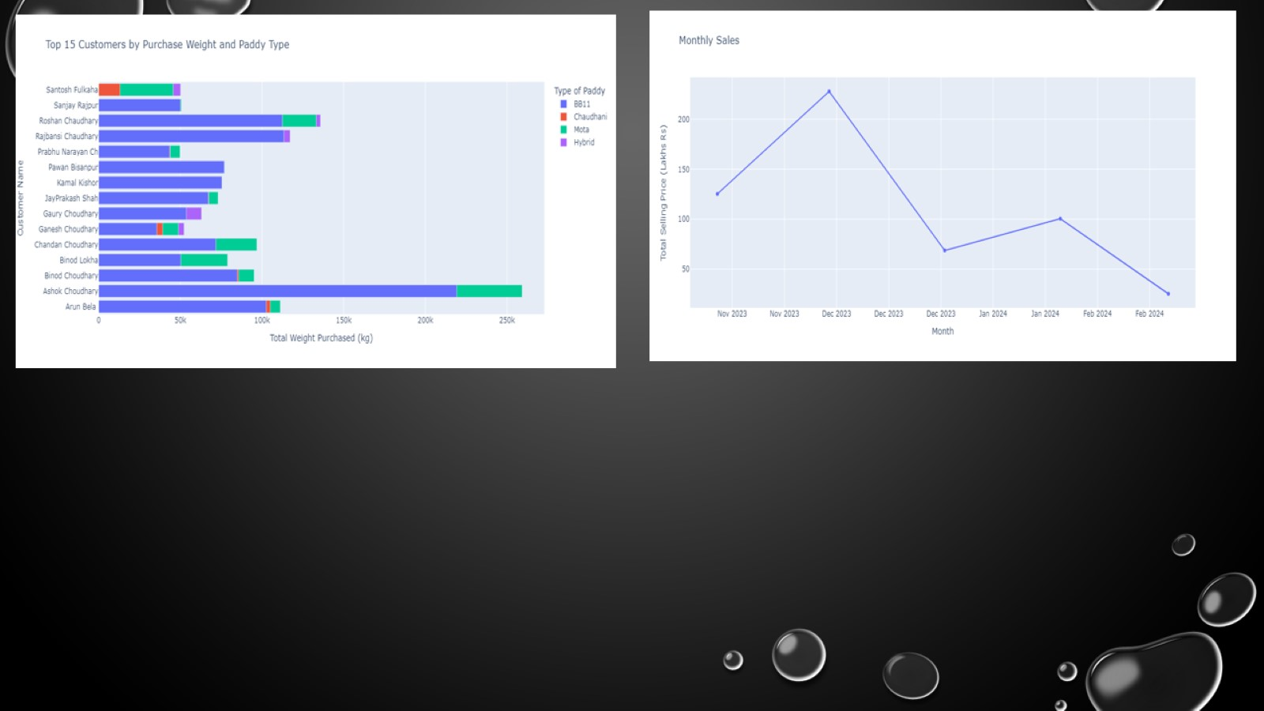

Slide 7
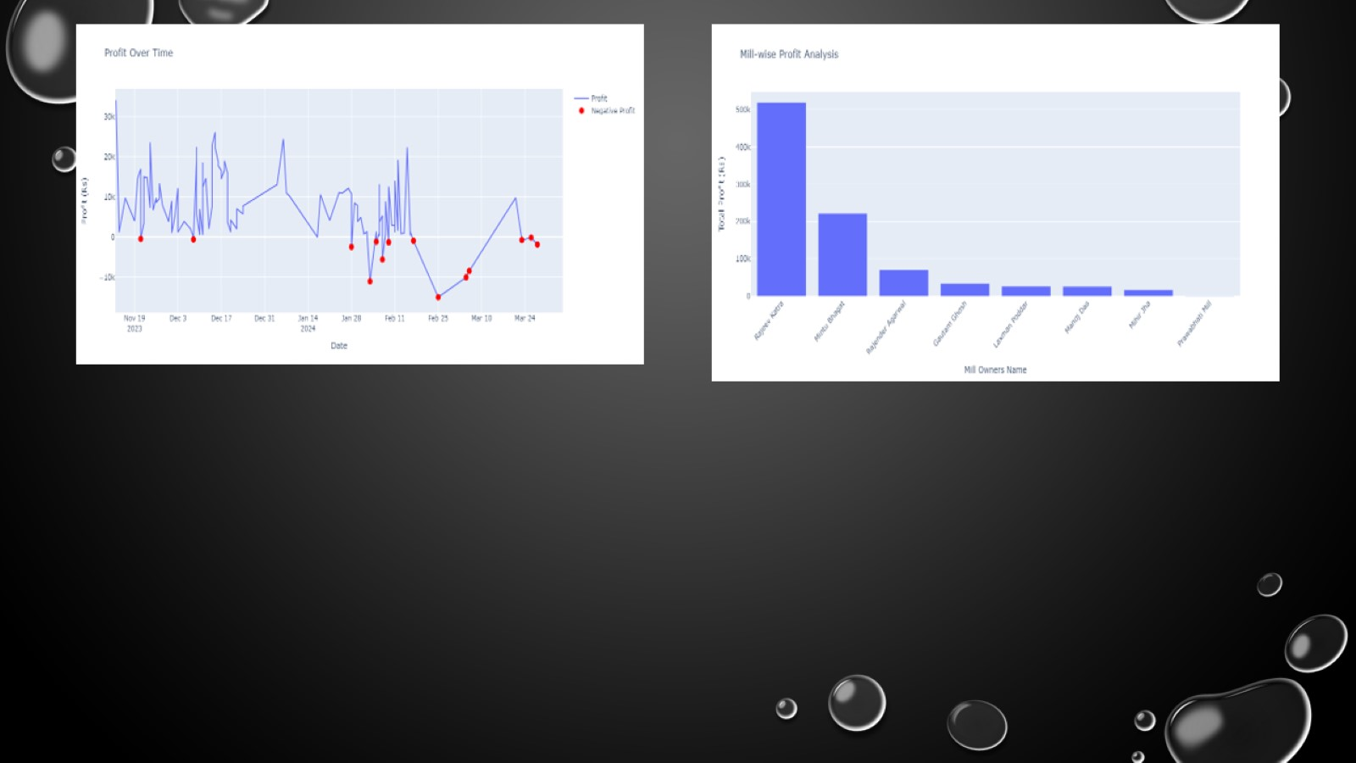

Slide 8
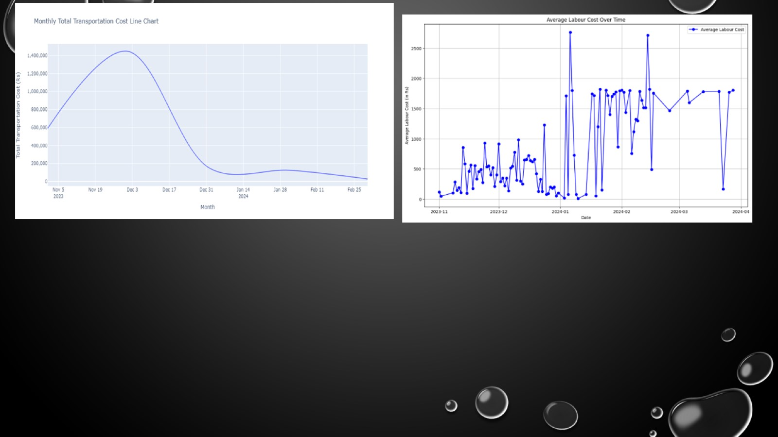

Slide 10


